Slide 1
10 Things I [re-] Learned from KBFS 2020
Andy Hines

Slide 2
10 Things I [re-] Learned from KBFS 2020
1. Foresight Serves Different Purposes
2. Foresight Is Innovating & Evolving
3. Thematic Directions
4. Re-Imagining Imagining
5. Rethinking Wild Cards
6. Visioning…for Futurists?
7. From Abstract to Concrete
8. Critical & Integral Mainstreaming
9. Cyclical, but Steady Growth
10. Futurists agree on more than we think!

Slide 3
1. Foresight Serves Different Purposes
Pragmatic
Progressive
Civilizational
today’s business better
beyond today’s practices
creating foundations of next world civilization
A healthy field has all three!

Slide 4
2. Foresight Is Innovating & Evolving
Aspirational Futures
Anticipatory Governance
Bibliometric mapping
Decolonizing Futures
Ethnographic
Experiential Futures
Four Futures
Archetypes
Design and Futures
Foresight Maturity Model
Framework Foresight
Foresight Competency Model
Integral Futures
Integral Strategy
Polak Game
Presencing
Post-Normal Futures
Professionalizing Foresight
Science Fiction Prototyping
Three Horizons
Wild Cards and Weak Signals

Slide 5
3. Thematic Directions
More nuanced approach to time (3 horizons)
More integrating qualitative-quantitative
More experimenting w/ IT-based and automated
More open and crowdsourced approaches
More imaginative
More experiential foresight
More interactive (games)

Slide 6
4. Re-Imagining Imagining
BDJ: Guide to Science Fiction Prototyping
Sci Fi Futures Course
Books, themed issues
Design Fiction, narrative prototyping, etc.

Slide 7
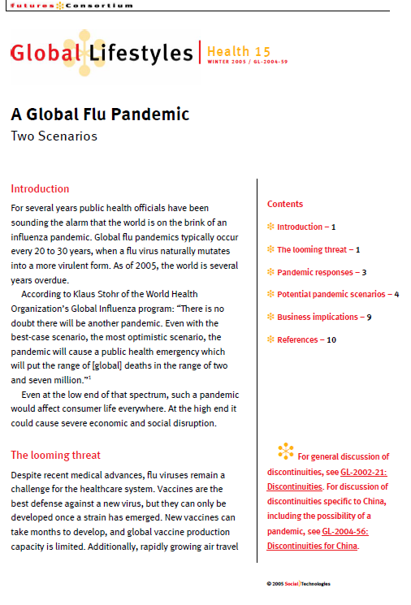
5. Rethinking Wild Cards
Wild Cards and Weak Signals
Wildcards depend on the vantage point of the viewer
Wildcards are often yesterday’s news to futurists
Opportunity for the Future: Improve Monitoring
2004!!!

Slide 8
6. Visioning…for Futurists?
“Aspirational Futures” at the core of [former] IAF
Some other futurists doing visioning work
World certainly needs more vision
BUT, much visioning work is not done by futurists
Should we change that?

Slide 9
7. From Abstract to Concrete
From written reports to videos, artefacts, simulations, experiences
“Experiential Futures,” family of approaches for making futures visible, tangible, interactive, and otherwise explorable in a range of modes.

Slide 10
8. Critical & Integral Mainstreaming
No longer “alternative”
CLA very popular approach
Moving into application space (Integral Strategy)

Slide 11
9. Cyclical, but Steady Growth
Education
Some are up – Turku; some are down – Swinburne; rest are “hanging on”
Governance:
Healthiest sector with growth at national (Policy Horizons) and global levels (anticipatory)
Corporate
Steady: growth in literature on corporate foresight

Slide 12
10. Futurists agree on more than we think!
Foresight Competency Model developed by APF

Slide 13
Your Turn
Each working group is asked to discuss what they believe are the most significant developments in foresight over the last 10-15 years.
Please be prepared to share your top 3 -5 with the full group when we reconvene.

